Slide 1

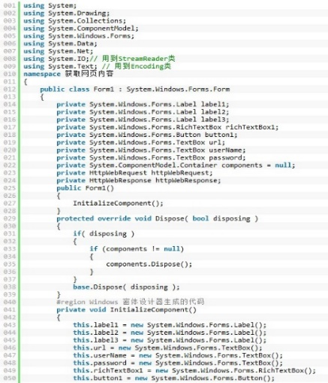
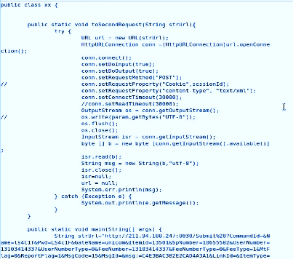
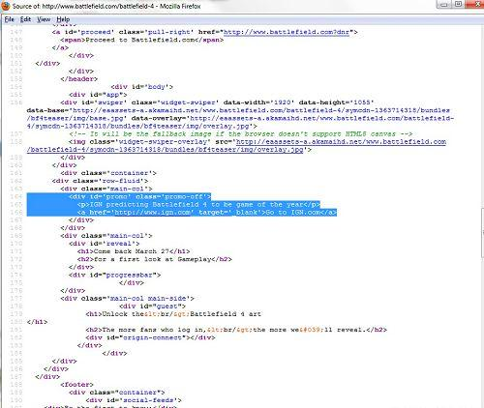
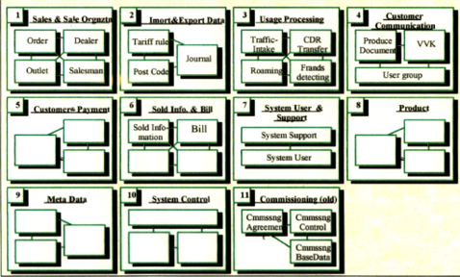
Automatic Software Re-architecture
Architecture
Transformation
Architecture
Recovery
Architecture
Implantation
H. Li, “Large-Scale Software Reuse & Large Complex System Re-Architecting,” Professional Lecture Series at Graduate School of Chinese Academy of Sciences, Beijing, China,2009.

Slide 2
Reference
H. Li and M. Looijen, “Legacy System Modernization (in Dutch)," , IT Management [Select], ISSN:13839667, Vol 5 No. 2, page 94-102, 1999.
H. Li, “Large-Scale Software Reuse & Large Complex System Re-Architecting,” Professional Lecture Series at Graduate School of Chinese Academy of Sciences, Beijing, China,2009.

Slide 3
Automatic Software Re-architecting 软件自动重构技术
The lecture is about the principles and algorithms of automatic software rearchitecting.
本章重点介绍软件自动重架构技术的原理和算法。

Slide 4
Software Data Mining and Unsupervised Machine Learning
for System Re-Architecting
Three-Step Approach
Architecture
Transformation
Old
Architecture
New
Architecture
In genetic engineering, we get gene structure from tissues and implant it back to the tissues.
Architecture
Recovery
Architecture
Implantation
Legacy System
Recovery – Get an architecture from existing system
Transformation – Restructure the old architecture into a new one.
Build In – Build the new architecture back into the existing system
Maintenance – Software Maintenance with the new architecture

Slide 5
Data Mining
Data mining is the computing process of discovering patterns in large data sets. The overall goal is to extract information from a data set and transform it into an understandable structure for further use.
Data mining is an interdisciplinary subfield of computer science, it is at the intersection of machine learning, statistics, and database systems.
The term is a misnomer( inaccurate), because the goal is the extraction of patterns and knowledge from large amounts of data, not the extraction (mining) of data itself.
Wiki and "Data Mining Curriculum". ACM SIGKDD. 2006-04-30. Retrieved 20*4-0*-27.

Slide 6
Software data mining
Software data mining: Analyzing static and active software resources of an application domain and recovering the knowledge and reusable artifacts from the resources, so that to support software development with large-scale reuse.
Reusable artifacts refers to any accessible parts of software resources that may be applicable in developing other systems.
Accordingly, software data mining covers more activities than reverse engineering, which is able to reuse the knowledge and artifacts of an existing software resources in a more broad way.

Slide 7
An Abstraction of Traditional Architectures
Principles such as simplicity and modularity are the stuff of software engineering; decentralization and tolerance are the life and breath of Internet. -- Tim Berners-Lee， www investor，1998
Keep it simple, stupid! – Tim Berners-Lee，1998
Relation-Oriented Architecture
Functions
Entities
Components
Services
Objects
The Relation between Functions/Data Entities
Relation
Between Components
The Relation between Objects
The Relation between Services
Traditional Architectures

Slide 8




Properties of ROA
ROA Makes Software Architectures Computable Artifacts
Relation-Oriented (ROA)
A system view from another corner
Higher level abstraction
Commonalities of the existing three.
A computable artifact.
Enabling transformation between different architectural styles
Function-Oriented (FOA)
Object-Oriented (OOA)
Service-Oriented (SOA)
**Our practical experience shown that, because of the computability, automatic architecting and re-architecting are possible.

Slide 9
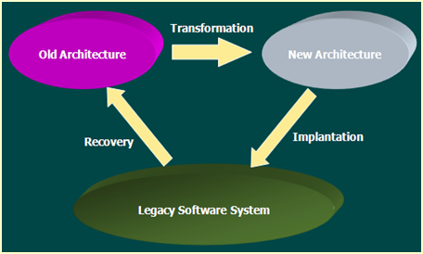

Architecture Recovery
Architecture Recovery is a kind of reverse engineering where in software is as data to be processed.
Software System
in Source Code
Architecture
Recovery
Components +
Relationship
Input
Output
Function-Function (Call/MSG)
Function-Data relation,
Data-Data Relation (ER)
Functions (Components)
Data Entities (Tables)
The Architecture refers to relation-oriented architecture that consists of all components and the relations between them.

Slide 10
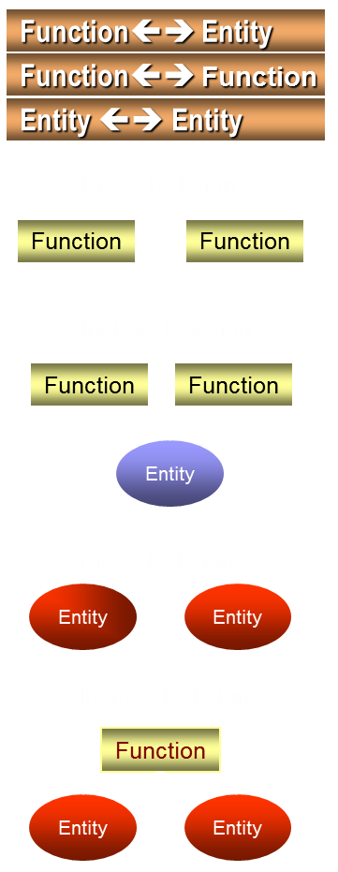
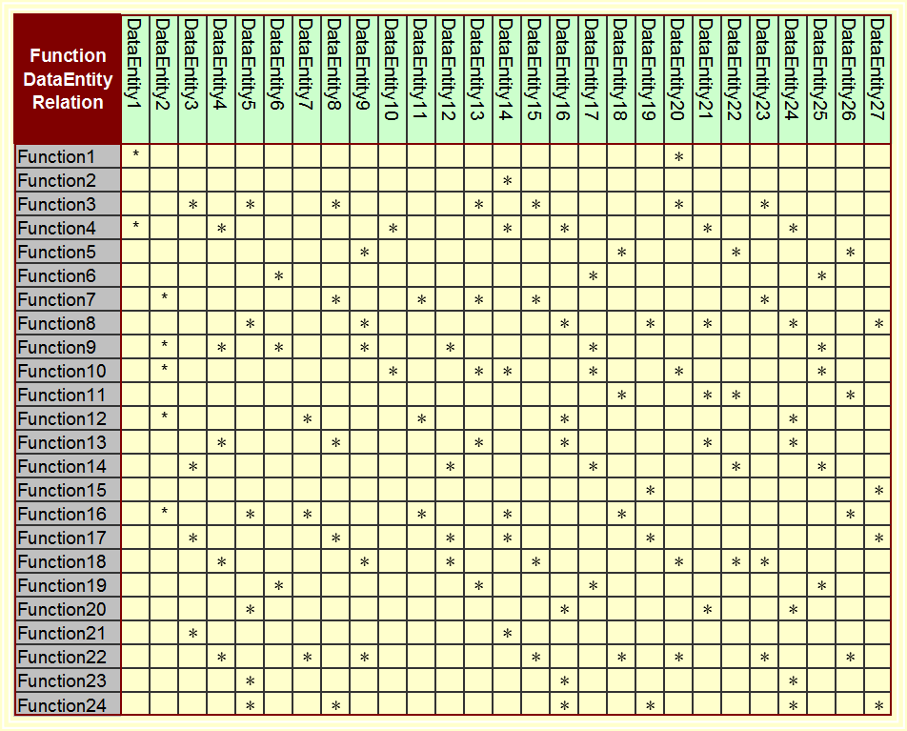
Architecture Recovery Function-Data Relation

Slide 11
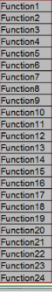
Architecture Recovery: Fun-Fun Matrix
Identify all the functions, including the name and address of each function.
Take the function names to identify the rows of a matrix.
Take the function names to identify the columns of the matrix.
Mark the relationships between the functions and functions.

Slide 12
Architecture Recovery Graphic representation

Slide 13
The 3-Step Approach to Software Re-Architecting
Architecture
Transformation
Old
Architecture
New
Architecture
Architecture
Recovery
Architecture
Implantation
Legacy System

Slide 14
Software Re-architecting
Software Re-architecting is a process to reorganize the organizational structure of the software into a more suitable one.
Physical Re-architecting is a process to reorganize the organizational structure of the software into a more suitable one, without changing the functionality and externally visible behaviors of the software.
Logical Re-architecting is a process to reorganize the organizational structure of the software into a more suitable one, by changing neither functionality , externally visible behaviors nor source code.
The question is, as discussed before, how could we change system architecture without modifying source code?

Slide 15
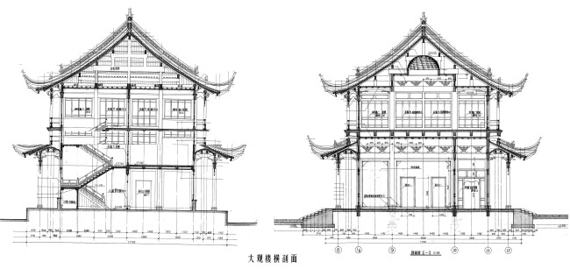
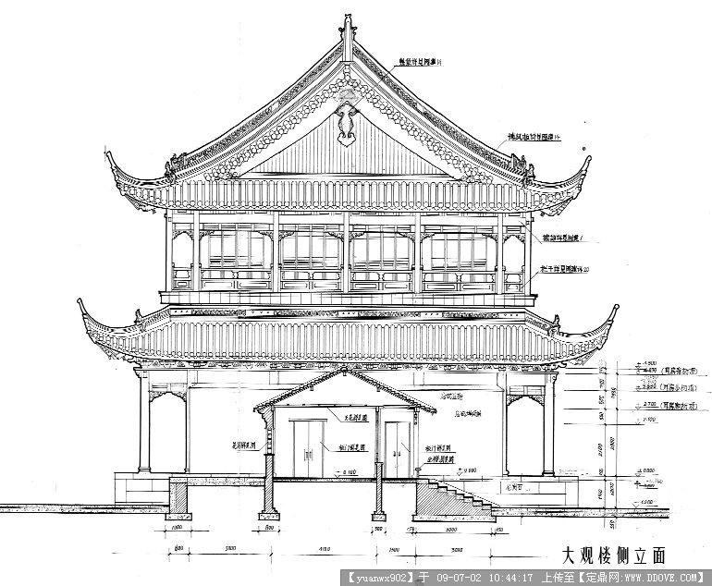
Transform a Legacy Architectural
Design into a Suitable One
To a given old building, if there is only a transformation from an old architectural design into a new one without changing the building, a logical re-architecting is done.

Slide 16
Logical Re-architecting

Slide 17
Logical rearchitecture
10 crossing lines
Put a vertical bar in the mid of the picture.

Slide 18
Logical Re-architecting
8 crossing line
Use your mouse to catch a functional component (circle) and move it from one side of the bar to the other side. Now, you may calculate the number of the lines that cross the bar. If the number of the lines are less than it was, please leave the component to the new place, otherwise, bring it back to the original position.

Slide 19
Logical Re-architecting
9 crossing line
Use your mouse to catch a functional component (circle) and move it from one side of the bar to the other side. Now, you may calculate the number of the lines that cross the bar. If the number of the lines are less than it was, please leave the component to the new place, otherwise, bring it back to the original position.

Slide 20
Logical Re-architecting
Following the same way, you may continuously try to move (or not move) the components from one side to another. The process may be continued until the crossing lines are minimized.

Slide 21
The result of the Logical re-architecting

Slide 22
Conclusion
Logical re-architecting is possible.
Logical re-architecting can be done automatically.
Logical re-architecting has its limitation.
Can you change system architecture without modifying the system code?
YES

Slide 23
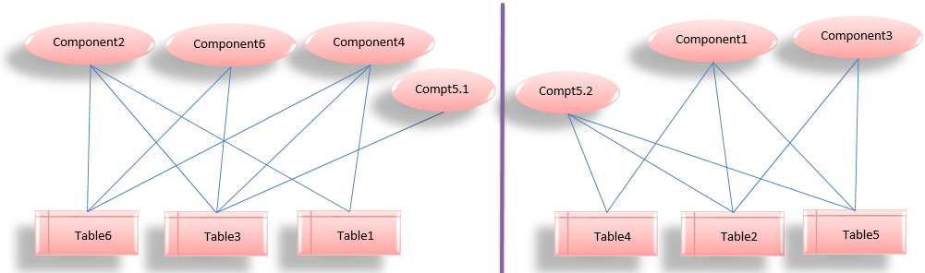
Physical Re-architecting
Splitting the bothersome components into two physically so that to access the data via message communication.

Slide 24
Physical Re-architecting
The process of identifying the semantics of the objects is called semantic analysis.

Slide 25

Software Re-architecting via Unsupervised Learning
Clustering is called Unsupervised Learning because no class label information is provided. For this reason, clustering is done by observing learning rather than by example. In the field of data mining, research has focused on finding suitable methods for efficient clustering analysis of large databases.
–Jiawei Han, 2012
Notes:
***聚类被称为无监督学习（Unsupervised Learning），因为没有提供类标号信息。由于这种原因，聚类是通过观察学习，而不是通过示例学习。在数据挖掘领域，研究工作一直集中在为大型数据库的有效聚类分析寻找合适的方法上。-韩家炜 《数据挖掘-概念与技术》2012.

Slide 26
Architecture Recovery
Architecture Recovery is a kind of reverse engineering where in software is as data to be processed.
Software System
in Source Code
Architecture
Recovery
Components +
Relationship
Input
Output
Function-Function (Call/MSG)
Function-Data relation,
Data-Data Relation (ER)
Functions (Components)
Data Entities (Tables)
The Architecture refers to relation-oriented architecture that consists of all components and the relations between them.

Slide 27
Architecture Recovery Function-Data Relation

Slide 28
Architecture Recovery Graphic representation

Slide 29
Architecture-based Impact Analysis
Impact analysis is a process to foreseen and evaluate all the consequences of system modification.
Impact analysis will mainly focus on the cost and the ripple propagation of system modification. It seems necessary to indicate that, to avoid complexity, functional enhancement will not be considered until the new architectural structure is available.
A tool for impact analysis must be developed before re-architecting so that the propagation areas of system modification for re-architecting can be identified and the cost of the modification can be estimated.

Slide 30

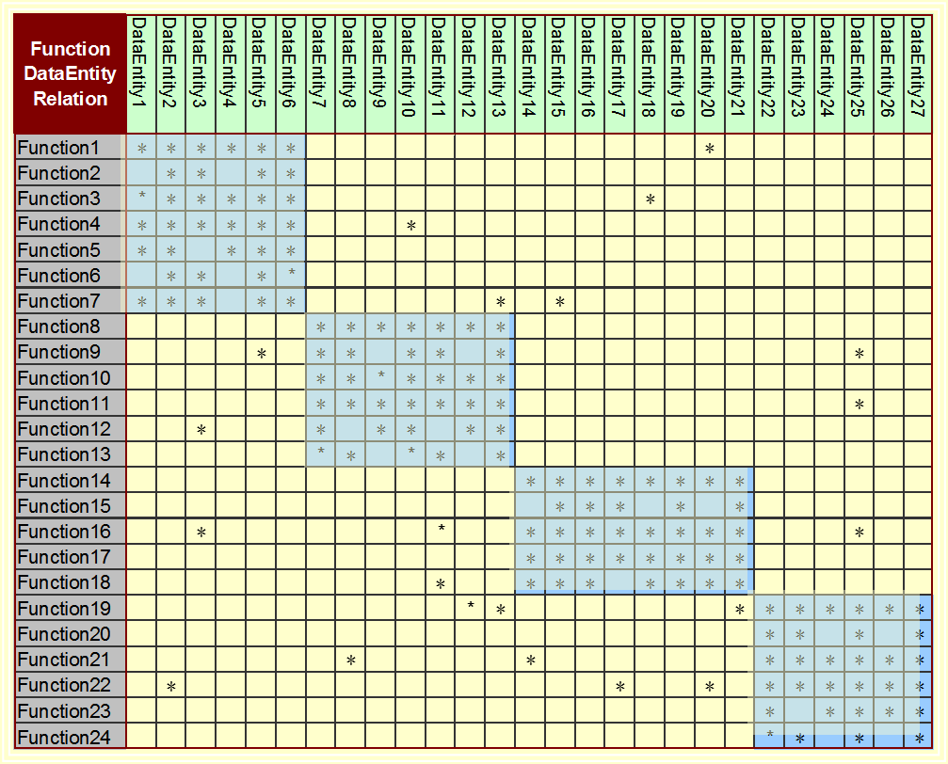
Logical Re-Architecting Relation-Oriented Clustering (Affinity Analysis)

Slide 31
Logical Re-Architecting Graphic Representation

Slide 32
Clustering Algorithm--Affinity Analysis

Slide 33
Clustering Algorithm--Affinity Analysis

Slide 34
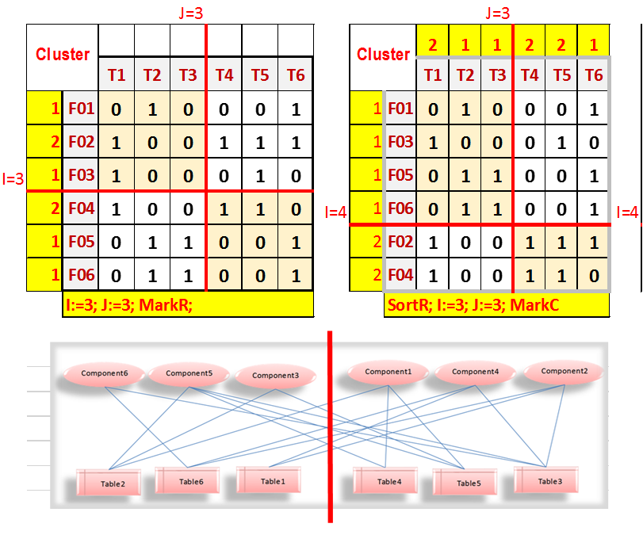
HLK Clustering Algorithm （1）

Slide 35
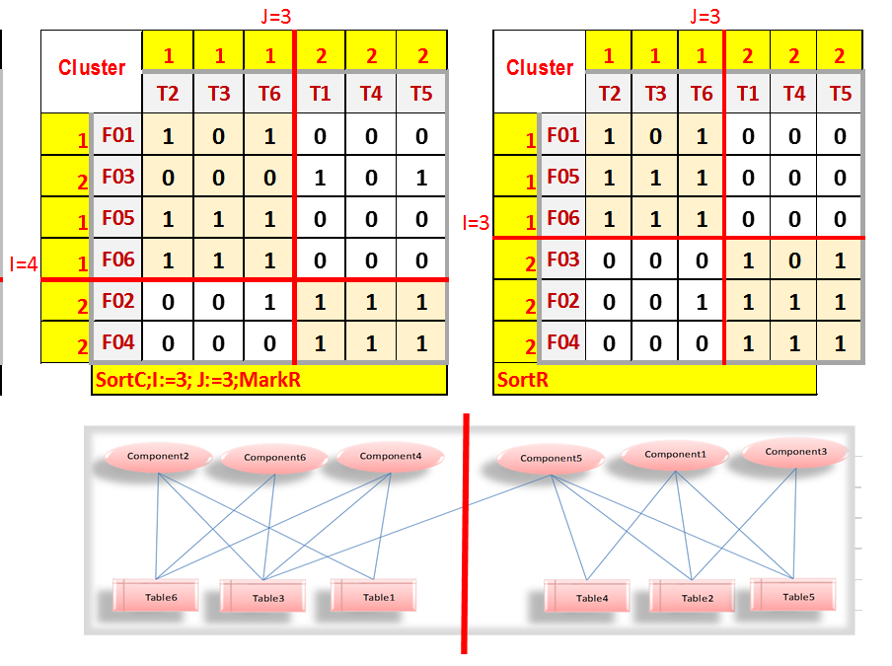
HKL Clustering Algorithm（2）

Slide 36
The Function-Data Matrix
 |  | T1 | T2 | T3 | T4 | T5 | T6 | T7 | T8 | T9
 | F01 | 0 | 1 | 0 | 0 | 0 | 1 | 0 | 0 | 0
 | F02 | 0 | 0 | 1 | 0 | 1 | 0 | 0 | 1 | 1
 | F03 | 0 | 0 | 1 | 0 | 1 | 0 | 0 | 0 | 0
 | F04 | 1 | 0 | 0 | 0 | 0 | 0 | 0 | 0 | 0
 | F05 | 0 | 0 | 0 | 1 | 0 | 0 | 0 | 1 | 1
 | F06 | 0 | 1 | 0 | 0 | 0 | 1 | 0 | 0 | 0
 | F07 | 0 | 0 | 0 | 1 | 0 | 0 | 0 | 0 | 0
 | F08 | 1 | 0 | 0 | 0 | 0 | 1 | 0 | 0 | 1
 | F09 | 0 | 0 | 1 | 0 | 1 | 0 | 0 | 0 | 0
 | F10 | 0 | 0 | 0 | 1 | 0 | 0 | 0 | 1 | 0
 | F11 | 0 | 1 | 0 | 0 | 1 | 0 | 1 | 0 | 0
 | F12 | 0 | 0 | 1 | 0 | 0 | 1 | 0 | 0 | 1

Slide 37

Clustering: Initiation
 |  | T1 | T2 | T3 | T4 | T5 | T6 | T7 | T8 | T9
 | F01 | 0 | 1 | 0 | 0 | 0 | 1 | 0 | 0 | 0
 | F02 | 0 | 0 | 1 | 0 | 1 | 0 | 0 | 1 | 1
 | F03 | 0 | 0 | 1 | 0 | 1 | 0 | 0 | 0 | 0
 | F04 | 1 | 0 | 0 | 0 | 0 | 0 | 0 | 0 | 0
 | F05 | 0 | 0 | 0 | 1 | 0 | 0 | 0 | 1 | 1
 | F06 | 0 | 1 | 0 | 0 | 0 | 1 | 0 | 0 | 0
 | F07 | 0 | 0 | 0 | 1 | 0 | 0 | 0 | 0 | 0
 | F08 | 1 | 0 | 0 | 0 | 0 | 1 | 0 | 0 | 1
 | F09 | 0 | 0 | 1 | 0 | 1 | 0 | 0 | 0 | 0
 | F10 | 0 | 0 | 0 | 1 | 0 | 0 | 0 | 1 | 0
 | F11 | 0 | 1 | 0 | 0 | 1 | 0 | 1 | 0 | 0
 | F12 | 0 | 0 | 1 | 0 | 0 | 1 | 0 | 0 | 1

Slide 38
Quality: Outside/Inside = 17/28
A
B
4
4
5
5
7
C
3

Slide 39
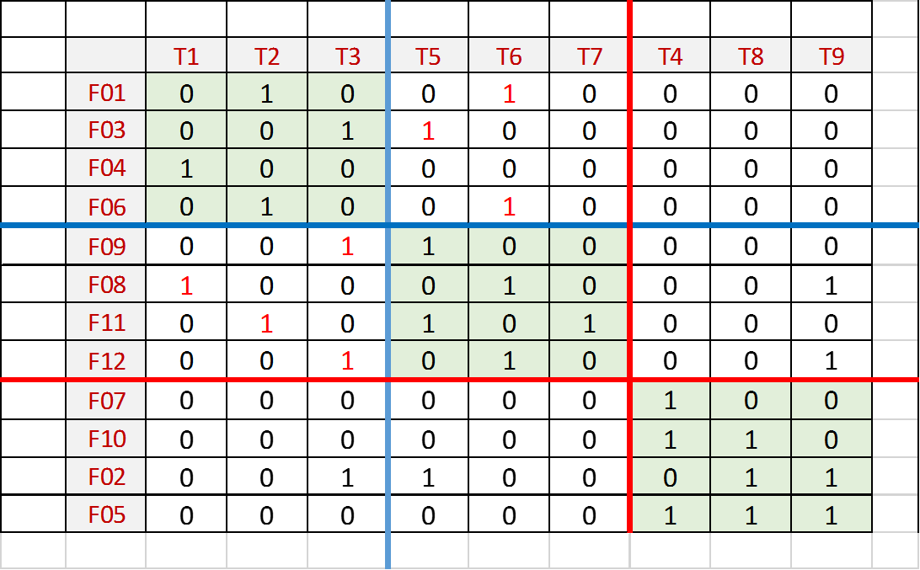
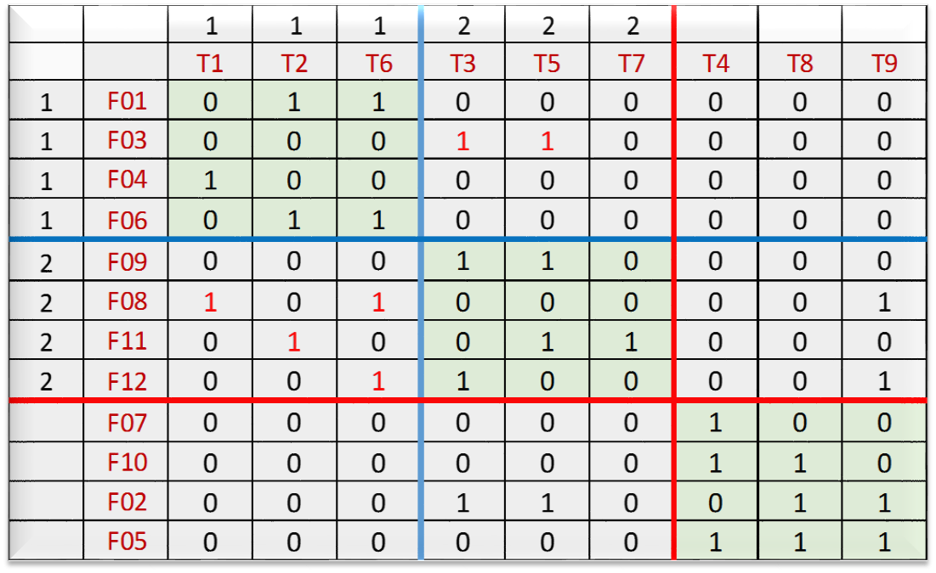
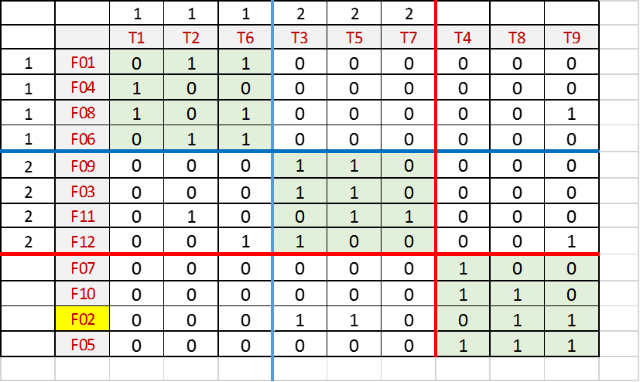
Results of the Low-Level Clustering
1
1
2
3

Slide 40
Quality: Outside/Total = 7/28
A
B
6
7
2
1
3
C
8

Slide 41
Logical Re-Architecting
Old-Architecture
New-Architecture
Transformation

Slide 42

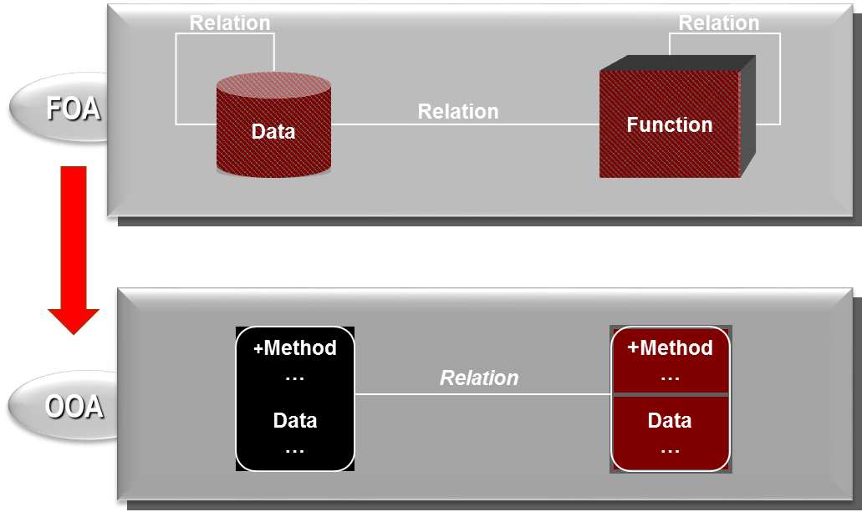
Architecture Transformation

Slide 43
Architecture implantation
Architecture implantation refers to building the new architecture into the legacy system so that the system can be understood and processed based on the architecture.
Old
Architecture
2
New
Architecture
*
3
Architecture
Legacy
System

Slide 44
Make the new architecture to Electronic Document

Slide 45
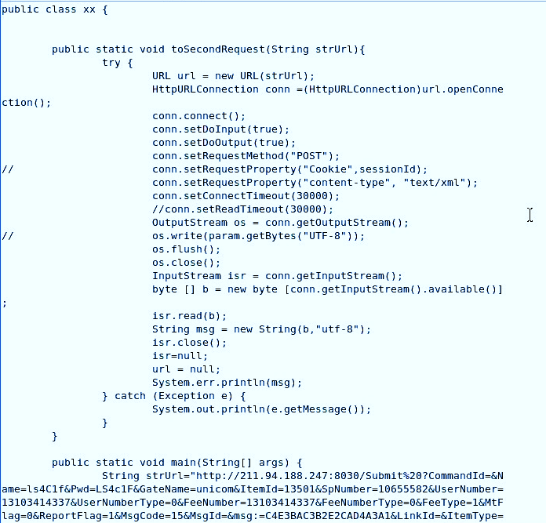

What is the link?

Slide 46
Reviewing the process of the 3-step approach
Architecture
Transformation
Architecture
Recovery
Architecture
Implantation

Slide 47

Case Study
A project for system modernization in a European
telecom company
Two problems about the legacy system.
First, the system documents are not consistent with the system anymore and the system maintenance is highly expert-dependent.
Second, the system structure, after a long term maintenance, was typically spaghetti like and therefore complexity is high.

Slide 48

Telecom System Re-architecting
Old-Architecture
New-Architecture
Transformation
Recovery
Implantation
Legacy System
Legacy System

Slide 49
A Set of Loosely coupled subsystems The Result of Re-architecting
Software
components
server comps
Software
DB
components
Tables
Server comps
Software
cmponents
Server comps
Object2
DB
Tables
DB
Tables
Object3
Object*

Slide 50
Object-Oriented Architecture Electronic Document

Slide 51
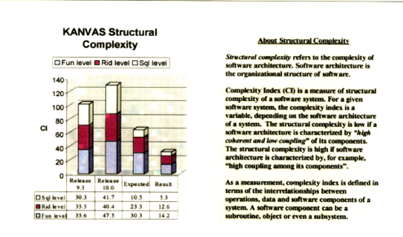
Evaluation on Structural Complexity

Slide 52
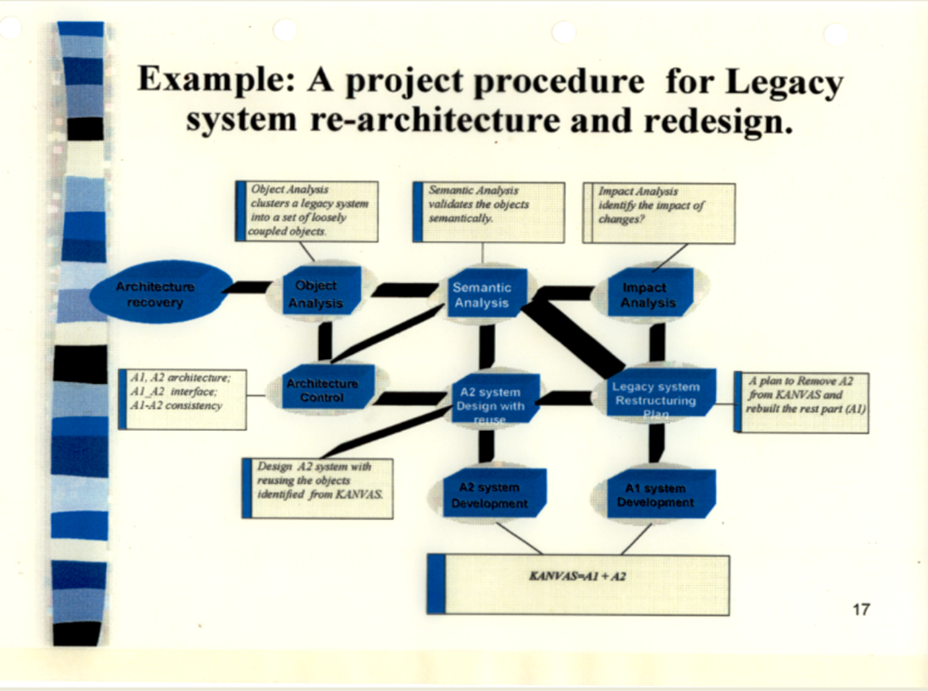

Slide 53
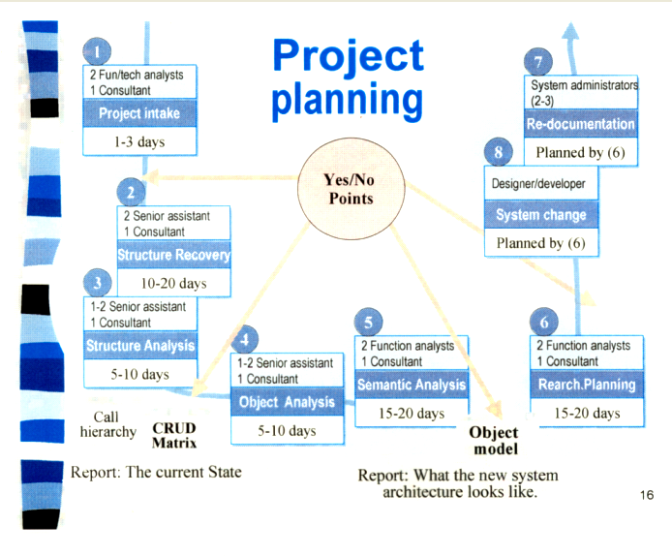

Slide 54
Data Analysis Pipeline
*
Acquisition/
Recording
Component dictionary
Get call hierarchy
Crud matrix
2
Extraction/
Cleaning/
Annotation
Three layer model = Presentation +Function +Data
Design Recovery
3
Integration/
Aggregation/
Representation
All source code
All documents
System Specialists
4
Analysis/
Modeling
Affinity analysis
Object modeling
Architecturing
Domain specialists
5
Interpretation
Electronic documentation
Usability interpretation
Complex evaluation

Slide 55

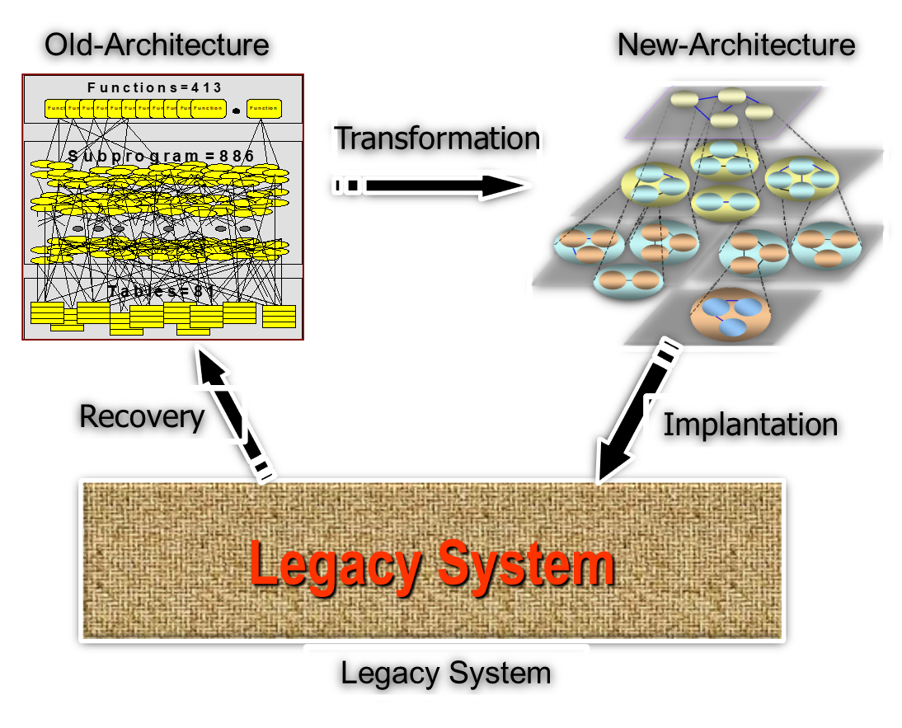
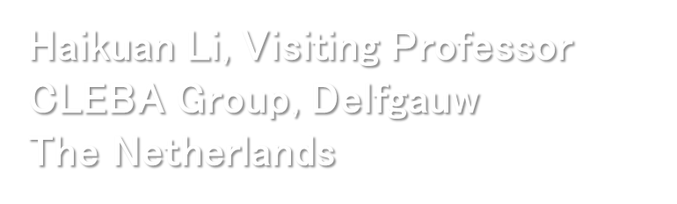
Q&A

Slide 56
Q&A：Automatic System Re-architecting
What is physical rearchitecting?
What is logical rearchitecting?
How to implement logical rearchitecting?
What is the difference between physical and logical rearchitecting?
What are the advantages of logical rearchitecting?
What is the limitation of logical rearchitecting?
How to implement architecture recovery?
How to implement architecture transformation?
How to implement architecture implantation?
How to implement system rearchitecting with the combination of logical and physical rearchitecting?

Slide 57
Reference: 机器学习
“机器学习”里“学习”的概念究竟是什么呢？这种叫法真的能反应它的实际内容所涵概的范畴吗？机器学习是不是叫机器智能或者机器思维更恰当？ Arthur Samuel定义的机器学习：在不直接针对问题进行编程的情况下，赋予计算机学习能力的一个研究领域；（这个定义比较宽泛，但还不失“学习”的本质，我们可以知道机器学习的程序不再是编一套程序发出一系列指令，而是一个赋予计算机某种思维能力比如从数据中找出某种规律进而方便以后应用的过程，这其实就是一个训练加应用的组合） 林轩田眼中的机器学习：机器学习想做的事情，简单的说是要从资料中归纳出有用的规则。大数据说的是对大量的资料做分析，而人工智能说的是让机器看起来更聪明，两者都可以使用机器学习来做核心的工具。 这么看下来，其实机器学习更应该称之为机器智能或者机器思维吧。 根据Tom Mitchell的定义：对于一个计算机程序来说，给它一个任务T和一个性能测量方法P，如果在经验E的影响下，P对T的测量结果得到了改进，那么就说该程序从E中学习了。 其实这个就是对学习最好的定义了，一定要有经验，其实经验就是数据，就是个训练的过程，这个训练的目的，是为了P对T的提升；如果这个提升是用在新的数据上，就是有监督学习，训练+测试；如果是用在自身上，就是自学习，那么自学习或者无监督学习和对数据进行分析是一回事么，如迭代不等于学习，聚类分析也不等于机器学习-CSDN.NET

